Slide 1

Native Language Classification
Gilad Eini & Liat Nativ

Slide 2

introduction
Most of the world is bi-language.
Internet is dominated by English – but :
There is evidence that most of the its dynamic content is written by non-native English speakers.
That is one of the reasons why distinguishing between naive and non-native speakers draws attention

Slide 3
Native Vs. Non-native
Native speakers language can be distinguished from non-natives by different features, such as [1] [2] :
Relative frequencies of specific letters or combinations of letters
Specific words or sequences of words
Parts of speech (POS) or sequences of POS
Specific errors or categories of errors
Abstract properties such as levels of cohesion, complexity and lexical diversity
Lexical diversity
polysemy

Slide 4
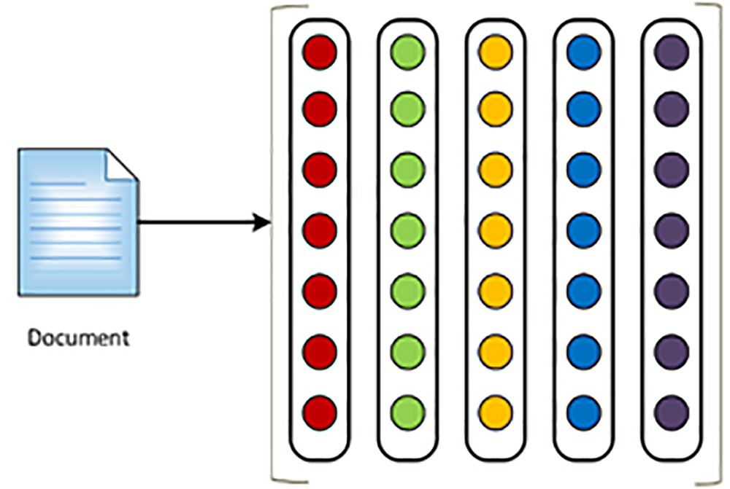
Classification Model
A bag of words model give good classification results BUT: suffers from content dependency – does not generalize well.
We were interested in creating content independent classification model.
Our choice was to observe the use of function words as a feature for classification. This is based on the use of this feature in the problem of machine translation [3] [4]
Function words are generally not related to any content – creating a “clean” and more generalizable classification model

Slide 5

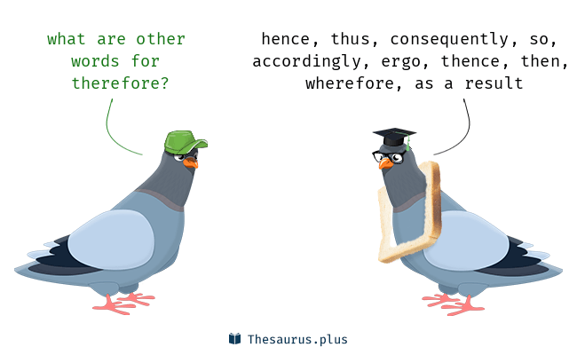
Function words
Many
Accordingly
Thus
Several
Amongst
Either
Certain
Ours
…

Slide 6

Data sets & Tools
Native speakers dataset collected from Reddit – a popular discussion website
Non-Native speakers dataset – TOEFL (Test Of English As A Foreign Language): a collection of assays written by non native English speakers as a university entrance test.
Function words dictionary: We downloaded a dictionary from the academic resources at Sequence Publishing Our dictionary consists of 311 function words
Non-Native data set is smaller than the native – To create balance we shuffled the native data set and used approx. same amount of samples for each class : each class consist of ~22,000 samples

Slide 7

Design &Implementation details
Selected programming language is Python
Data preparation:
Lower casing data sets (function words dict. is lower - case)
Sentence picking (at least 45 tokens per sentence)
Feature vector construction:
For each sample (sentence) – count the occurrences of each function word → feature vector dimension is 311
Feed the feature vectors to different classifiers.

Slide 8
Design & Implementation details
We tested 3 different classifiers for our task:
Decision Tree Building a decision tree from the samples - where the top most node is the one with the smallest entropy.
Naive Bayes: Simple probabilistic classifiers with strong (naive) independence assumptions between the features.
SVM (Support vector machine) An SVM model represent samples as points in space. Example of the separate categories are divided by a clear gap that is as wide as possible. When data is non-linear separable - data is mapped to higher dimension feature space in which it is separable (kernel). We used RBF kernel (Radial Basis Function).
We used 3-fold cross validation for training-test set divisions for each of the classifiers.

Slide 9

Model Comparison??
As mentioned earlier a bag of words approach is effective for this binary classification task.
In order to create a more complete perspective we also classified based on this approach, for comparison.
We took the top 343 frequent words (no function words)
started from 230 from each data set – and remove duplicates
Created new feature vectors based on the 343 words count
Same settings

Slide 10
Results
Function words:
Naïve Bayes |  | Decision Tree |  | SVM
Native | Non-Native | Native | Non-Native | Native | Non-Native
0.8 | 0.795 | 0.69 | 0.7 | 0.807 | 0.825 | Precision
0.791 | 0.8 | 0.7 | 0.69 | 0.83 | 0.8 | Recall
0.797 |  | 0.69 |  | 0.816 |  | F
0.798 |  | 0.697 |  | 0.816 |  | Accuracy
BOW:
Naïve Bayes |  | Decision Tree |  | SVM
Native | Non-Native | Native | Non-Native | Native | Non-Native
0.93 | 0.93 | 0.88 | 0.87 | 0.89 | 0.97 | Precision
0.93 | 0.93 | 0.87 | 0.88 | 0.972 | 0.882 | Recall
0.93 |  | 0.875 |  | 0.93 |  | F
0.93 |  | 0.875 |  | 0.93 |  | Accuracy

Slide 11
Conclusion & future work
Function word approach yields inferior results compared to the bag of words approach, Yet it achieve reasonable scores, and is robust in respect to domain and time. In addition, the dimension of the feature vector remains constant.
Our next goal is task of native language identification: This is a much harder task of identifying the writer native language from an English written text and we will use deep learning techniques for this (RNN)

Slide 12
References
[1] Jarvis, Scott ; Paquot, Magali. Native language identification. In: Granger S. ; Gilquin G. ; Meunier F., Cambridge Handbook of Learner Corpus Research, Cambridge University Press : Cambridge 2015
[2] Shared features of L2 writing: Intergroup homogeneity and text classification Scott A. Crossley a, *, Danielle S. McNamara b,1
[3] Moshe Koppel and Noam Ordan Translationese and its dialects. In Proceedings of the 49th Annual Meeting of the Association for Computational Linguistics: Human Language Technologies, pages 1318{1326, Portland, Oregon, USA, June 2011. Association for Computational Linguistics [4] Vered Volansky, Noam Ordan, and Shuly Wintner On the features of translationese Literary and Linguistic Computing, Volume 30, Issue 1, 1 April 2015, Pages 98–118 03 July 2013

